Slide 1
GRD NETWORK
Presentation to bird board
Dec 14 2016

Slide 2
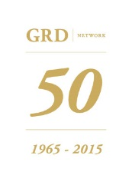

Agenda
Objectives, membership and financials
2016 and 2017 programs
Governance

Slide 3
The GRD Network
The network to make Belgium a better place for public and private R&D
The GRD Network was created in 1965 as the “Groupe Recherche-Développement de Louvain” in order to promote networking and collaboration in the field of public and private R&D. It is a not-for-profit initiative.
The GRD Network is a member-only community gathering the managers of leading public and private organizations engaged in R&D activities in Belgium and Luxemburg. Its members meet once a month (except in the summer) to share their experience and discuss R&D-related issues and best practices during half-day workshops. The workshops are hosted by the members (in turn) and include a networking lunch and a site visit. Membership is personal and upon invitation only.
The objective of the GRD Network is to facilitate networking and cooperation of large and medium size firms, universities and research centers and therefore improve the effectiveness of public and private R&D initiatives in Belgium and Luxemburg.
Until 2014 the GRD was managed by Prof. Raymond Collard, who turned it into a major hub gathering both leading medium-size and large firms active in R&D and leading universities and research centers. Since September 2014 it is managed by the Louvain Innovation team under the supervision of Prof. B. Gailly from UCL, with the support of the GRD Board.
Since Jan 1, 2015 the GRD has also received the support of the Belgium Industrial R&D (BiR&D) association, whose members are now part of the GRD Network.
Source: www.grdnetwork.be

Slide 4

BIR&D – GRD PARTNERSHIP
Objectives | Stimulate the attractiveness and the effectiveness of industrial R&D in Belgium leveraging collaborative innovation | Facilitate networking and cooperation of large and medium size firms, universities and research centers and improve the effectiveness of public and private R&D initiatives in Belgium
Activities | Specific actions deployed to strengthen the various components of this mission | Monthly networking workshops, including the BIR&D annual event
Membership scope | International industrial companies with major operations and substantial R&D activity in Belgium | R&D managers from public & private organizations, including all BIR&D members
Governance | GRD invited to BIR&D board as Associated Partner | At least 3 BIR&D representatives in GRD Board

Slide 5
GRD Meetings TEMPLATE (INDICATIVE)
09.00
09.30
10.00
10.45
11.00
11.45
12.15
12.30
13.15
14.00
Coffee – welcome
Introduction by management – brief overview of the organization and its main R&D-related aspects
Practice – sharing : presentation of an R&D-related project, with key challenges and lessons learned
Break
Practice – sharing : presentation of an R&D-related process, with key challenges and lessons learned
Stepping back : presentation of a special “thought provoking issue”, potentially involving external speaker or a start-up with whom the host is collaborating
Closing comments and personal invitation to next meeting
Brief site visit
Networking lunch
Closing

Slide 6
MEMBERSHIP
The GRD Network gathers the managers of leading public and private organizations engaged in R&D activities in Belgium and Luxemburg.
Membership is upon personal invitation only. A member can invite a colleague to replace him/her as “back-up” if he/she cannot attend a workshop. Members are invited to join the GRD LinkedIn group if they wish. All BIR&D company representatives are invited
The membership fee amounts to 1650 Eur/year (HTVA) for non-academic members and 825 Eur/year for academic members; University representatives (maximum one per University) do not have to pay a fee. The BIR&D contribution is currently fixed at 1000 EUR/year per member
Members are expected to host a GRD workshop in their premises once every three to four years. This hosting member can invite extra guests to the workshop held in its premises.
Board members can invite prospective members to a workshop.

Slide 7
CURRENT MEMBERSHIP
65 Managers (+6 – 2* in 2016) from:
  BIR&D firms: 25 (+DEME)
  Other firms: 23 (+Jindal, Lotus Bakeries, Engie, Tivecoma)
  Universities: 6
  Research centers: 8
  Other: 7 (+FISCH)
+ 25 Alumni (former GRD members still professionally active)
* CIM Flanders and VITO

Slide 8
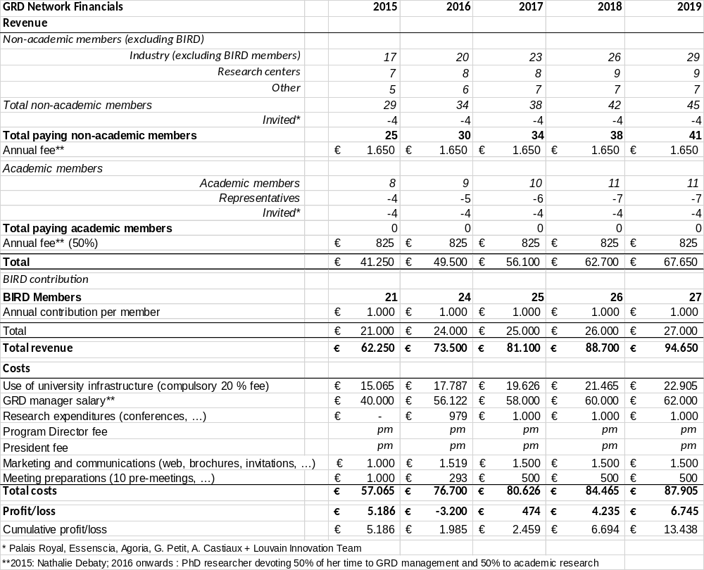

Slide 9
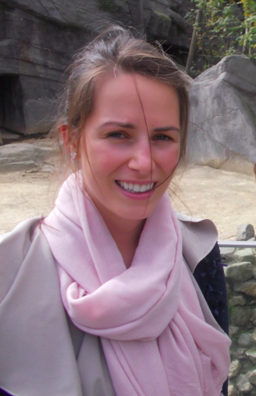
GRD PHD
Charlotte de Kort
PhD student in Strategy & Innovation at LSM (UCL)
PhD research project:
“What are the key determinants of organizational innovation
and how can networking activities influence the firm’s innovation capability?”

Slide 10
2015-2016 A multi-level framework of the determinants for organizational innovation- A systematic literature review (submitted)
 | structure | systems | resources | culture | Learning and knowledge management | leadership
Individual level
Firm level
Network level
Macro level
Multi level
2016-2017 The impact of network governance and activities on innovation benefits: a case study (paper in progress)

Slide 11
2016 program
January 13th | WAGRALIM | June 8th | UGhent
February 17th | GSK | September 14th | Cetic
March 9th | LABORELEC | October 12th | KU Leuven
April 13th | SOLVAY | November 9th | BEA
May 11th | BIR&D Event | December 14th | Magotteaux

Slide 12
2017 program
January 11th | Sonaca | June 14th | Air Liquide
February 8th | RHID | September 13th | NMC
March 8th | Cargill | October 11th | OCAS
April 19th | AWT | November 8th | Prayon
May 10th | BIR&D Event (tbc) | December 13th | Recticel

Slide 13
board structure
Core members (2017)
S. Vandeputte, GRD President, Managing Director OCAS N.V.
B. Gailly, GRD Program Director, Professor, Louvain Innovation
P. Denoël, Director Scientific Affairs and Opportunities, GSK
H. Derache, General Director, SIRRIS/Agoria
M. Mertens, R&D Manager, Magoteaux International
M. Foguenne, Chief Technology Officer- Building & Industrial Division, AGC GLASS EUROPE
Y. Verschueren, Managing Director, Essenscia
B. Wallaeys , Recticel R&D
F. Heroufosse, Managing Director, Wagralim
M. Morant, Managing Director, ULG Interace Entreprises - Université
J-J. Pireaux, LISE (PMR) Managing Director, Fac. of Science – UNamur
W. Van Camp, General Manager UGhent Technology Transfer, UGhent
P. Van Dun, General Manager of Leuven Research and Development, KU Leuven
J. Vyncke, Director Research & Innovation, WTCB-CSTC

Slide 14
board structure
Honorary members
R. COLLARD, Professor, Honorary President
S. ALEXANDRE, General Manager and Partner, FAKTORY – BELINVEST s.a.
R. AMPE, Director, VITO
M. Beguin, Directeur, Symbiose Biomaterials S.A.
C. CASSE, Corporate Vice-President R&D, HUTCHINSON S.A.
E. HANON, Vice-President R&D, GSK VACCINES
J-C. HERMAN, Managing Director, CRM GROUP
J-P JANSSENS, Research Director, BOSAL GROUP
J-D. LEGAT, Full professor, EPL – Université Catholique de Louvain
E. LOX, Senior Vice-President Government Affairs, UMICORE
A. OPSOMMER, Director Research & Technology, PROMAT RESEARCH & TECHNOLOGY
J. PINTE, Former General Manager, AGORIA
R. SPORKEN, Full Professor, Vice Dean, UNamur
P. VAN HOUTTE, Full Professor, KU Leuven
J. VENSTERMAN, Managing Director, WTCB – CSTC - BBRI

Slide 15
THANK YOU!

