Slide 1
May 8th 2019
12.00pm
BiR&D Board meeting
Bluepoint Brussels

Slide 2
Agenda
Antitrust declaration - all
Approval of the Minutes of the Board Meeting of 3 April 2019 – Marnix
Financials
Feedback IMU event
PhD awards
Next meetings / seminars
Targeted new members
Miscellaneous

Slide 3

1. Antitrust declaration

Slide 4

2. Approval of the Minutes of the Board Meeting of 03/04

Slide 5

3. Financials – 2018 & 2019
Reporting updated to align it with DBM official reporting (see below full report)
Actuals 2018: better than budgeted, negative result due to investment in 10th anniversary event
Accounts: is picture at YE, still some invoices to be paid in 2019 dating from 2018
Budget 2019: as presented on board meeting of Dec. 4th (target is to have positive result in 2019)
  As presented and approved on board meeting of Dec. 4th, 2018
  Target is to be (slightly) positive in 2019
  For approval on General Assembly

Slide 6
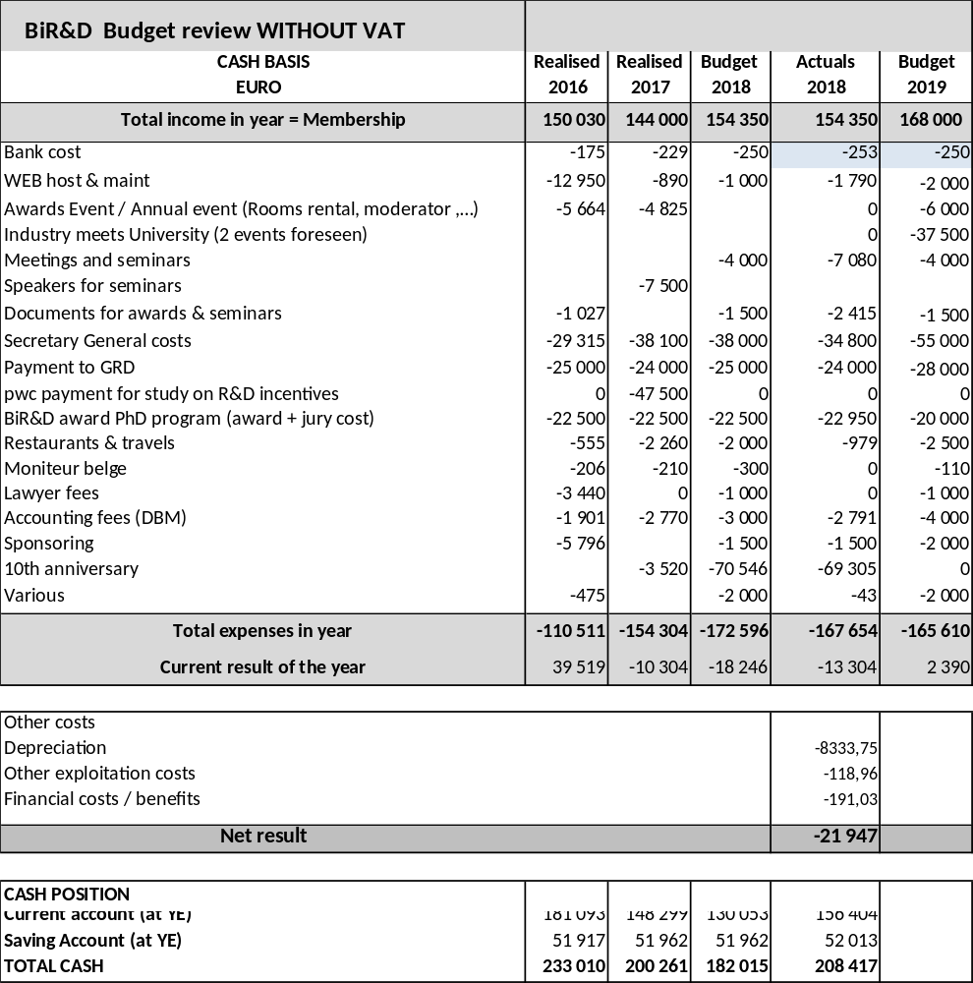
3. Financials – 2018 & 2019

Slide 7
4. Feedback IMU event
19 March 2019 – Salons de Romrée in Grimbergen
197 subscriptions of which 84 in industry (16 people didn’t show up)
120 pitches in:
  Health
  Materials & Energy
  Food
  Industry 4.0
Return on evaluation survey (39 returns)
  Location, organization and timing mostly appreciated
  Some attendants mentioned a lack of people from the industry
  For some the breaks were too long (due to the speed of presentations) or too short
  Suggestions: differentiate badges for industry and university, improve the way to find the interesting person during the break
  Contacts with a potential of collaboration: 83 (U–I 64, U-U 16, I-I 3)
  Most people suggest organizing an event like this every 2 years
  An idea about the industry pitching relevant topics as they are searching for collaboration

Slide 8
5. PhD awards
Findings:
  Strong response in number of applications
  Cross-disciplinarity remains a concern
  Limited interest observed from BiR&D members to participate in evaluation
  High cost to BiR&D – what about the return ?
View confirmed by board ? Perceived value ?
Alternatives:
  Continue as is
  Adapt price type
  Adapt price type & value
  Stop BiR&D awards
Proposal to decide on next board meeting in June

Slide 9
6. Next meetings / seminars
Upcoming seminars / meetings:
  05/06/2019: 3M Zwijndrecht – 2pm (topic to be confirmed)
  11/09/2019: Solvay – 2pm “European support to R&D”
  24/09/2019: University meets industry (focused on health)
  09/10/2019: Deme – 2pm - “Ahead of digital”
  06/11/2019: Baxter (tbc) – 2pm – topic to be confirmed
  04/12/2019 (tbc): board meeting over lunch (Bluepoint – Brussels)
Topics of interest:
  European support to R&D – interesting to have an EC speaker about the new R&D programs
  Financial aspects of R&D
  People related topics (talent acquisition, retention, diversity, …)
  Brexit
  AI / Big data analytics / Cyber security
  PPP’s
  Others ??
Workgroup on talent will continue to have sessions
Continued working group meetings on energy and health

Slide 10
7. Targeted new members
Contacted:
  IBA: positive answer, however change at our contact level
  Agfa: no formal answer yet
To be contacted (all have been invited to IMU)
  Picanol
  Chronos
  Siemens
  Eastman
  Sonaca
  Asco
  Barco
  Safran
  NXP
  Vandemoortele and other food companies
Focussed approach over next 4 months by president, vice-president and secretary-general to get new members on board

Slide 11
8. Miscellaneaous
New Vice-President proposed

Slide 12
May 8th 2019
1pm
BiR&D General Assembly
Bluepoint Brussels

Slide 13
Agenda
Welcome and Signing of Attendance List
Approval of the Minutes of the General Assembly of 9 May 2018
Financial report and approval of the accounts 2018 as proposed by the Board
Discharge of Board members
Approval of Budget 2019 as proposed by the Board
Confirmation of decision by the Board concerning Memberships and revocation and nomination of Board members

Slide 14

Approval of the Minutes of the General Assembly of 9 May 2018

Slide 15
Financial report and approval of the accounts 2018

Slide 16
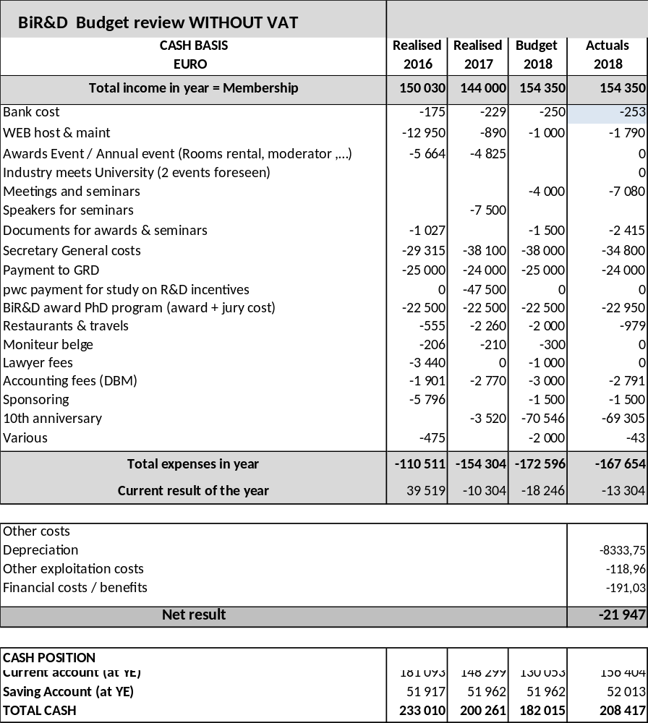
Financial report and approval of the accounts 2018

Slide 17
Discharge of Board members
Voting on discharge of Board members, based on information presented on 2018

Slide 18
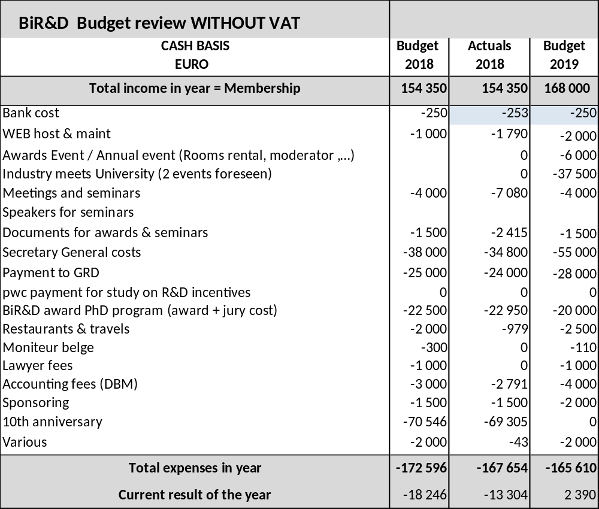
Approval of Budget 2019 as proposed by the Board

Slide 19
Memberships and revocation and nomination of Board members
New representatives:
  Bekaert: Geert Van Haver -> Veerle Van Wassenhove
  Solvay: Thierry Collard → Ludovic Odoni
  UCB : Simon Dresse→ Benoît Kenda

Slide 20
Vice Chairman
Vice Chairman : proposal to nominate Marc Foguenne (starting from May 8th, 2019 for a period of 3 years).

